Slide 1

Assignment 2:
Data Visualization & Analysis with MATLAB
Group 19s’ presentation explores the power of MATLAB in organizing, interpreting, and effectively visualizing complex datasets.

Slide 2
Team Contributors
NTALE JOASH KATEREGA
BU/UG/2024/2595
WAR
WANYAMA JOSEPH EROGO
BU/UP/2024/1077
WAR
KAKULU ALFRED
BU/UP/2024/0981
MEB
OKORI DARIOUS
BU/UP/2024/1061
WAR
ALITEMA VICTOR
BU/UP/2024/5098
WAR
AMASO SUSAN
BU/UP/2025/5435
PTI
SIKUKU BELIZER RUTH
BU/UP/2024/0846
AMI
TWICHIRIZE FLORENCE
BU/UP/2022/1836
WAR
OKWI NICHOLAS
BU/UP/2024/4457
WAR
MAATE PHILEMON
BU/UP/2024/0830
AMI

Slide 3
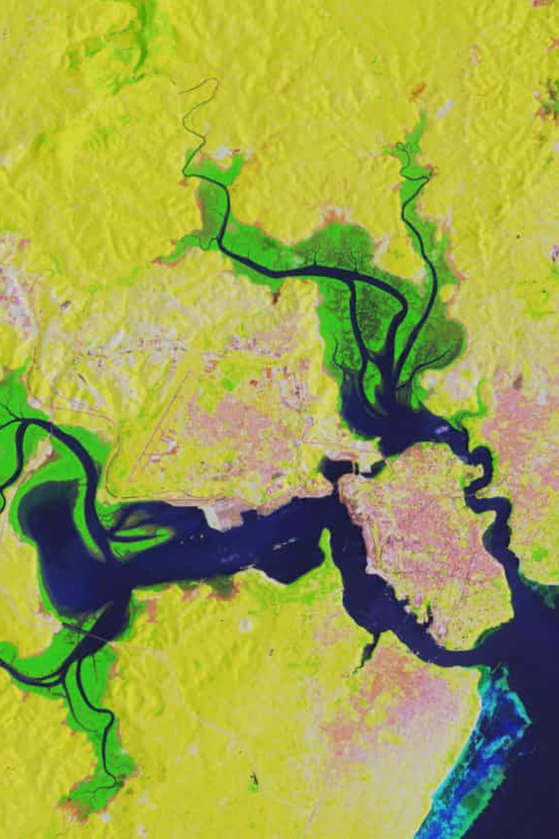
Study Methodology: Part One
We analysed a multi-year water pollution and disease dataset from Kaggle, focusing on visualising patterns, distributions, and relationships.
1
2
Import & Structure
2D & 3D Visualisation
Import and understand dataset structure in MATLAB.
Apply correct plotting functions for diverse visualisations.
3
Frequency & Trends
Show frequency, trends, and cumulative effects using charts.

Slide 4




Study Methodology: Part Two
We used individual descriptive details of group members, stored as MATLAB structure variables, to create statistical and graphical summaries of group diversity.
Load Variables i.e. struct
Load previously saved variables into the current script.
Convert to Table
Convert data to table format for easier access.
Statistical Description
Describe statistical characteristics like median and mean ages.
Visualise Data
Visualise statistical information using various plots.

Slide 5
Design Process: From Data to Insight
Initial Data Exploration
1
Checked variable types and relationships for meaningful plots.
2
Collaborative Coding
Held meetings to develop MATLAB script code from lecture notes.
Peer Consultation
3
Inquired from other groups and refined ideas.
4
Code Implementation
Wrote the MATLAB code for both assignment parts.
Descriptive Statistics
5
Computed means and sums for numerical columns, grouped by region and year.
6
Visualisation Creation
Created line, scatter, bar, pie, and Pareto plots.
Output Saving
7
Saved plots as images for compliance.
8
Debugging
Performed debugging with all available members for better understanding.

Slide 6
IMPOTRANT LINES OF CODE USED
Summarizing data by Year and Including mean Diarrheal Cases YearSummary = groupsummary(wpmain,"Year","mean","DiarrhealCasesPer100_000People");Here we used the “groupsummary” function to combine data for multiple years into one thus reducing the amount of data to be plotted.
This line of code was used to delete the groupcount column that automatically appears when using groupsummary. regionYearSummary2.GroupCount = [];
We used to “unstack”, to convert the region column to a row. regionYearSummary3 = unstack(regionYearSummary2, 'mean_DiarrhealCasesPer100_000People','Region');

Slide 7
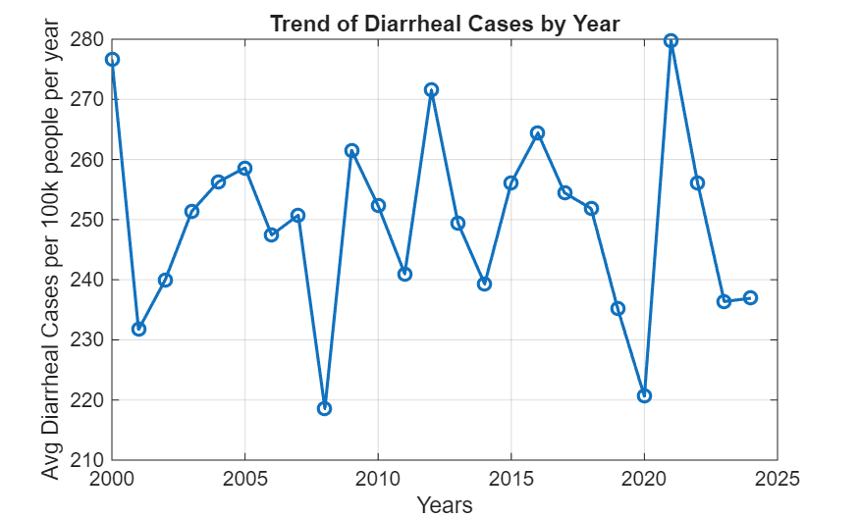
Water Pollution & Disease Trends
We extracted data from the water pollution and disease dataset, separating it by year and summarizing diarrheal cases.
This line graph illustrates the average diarrheal cases per 100,000 people over different years, highlighting an unsteady upward trend.

Slide 8
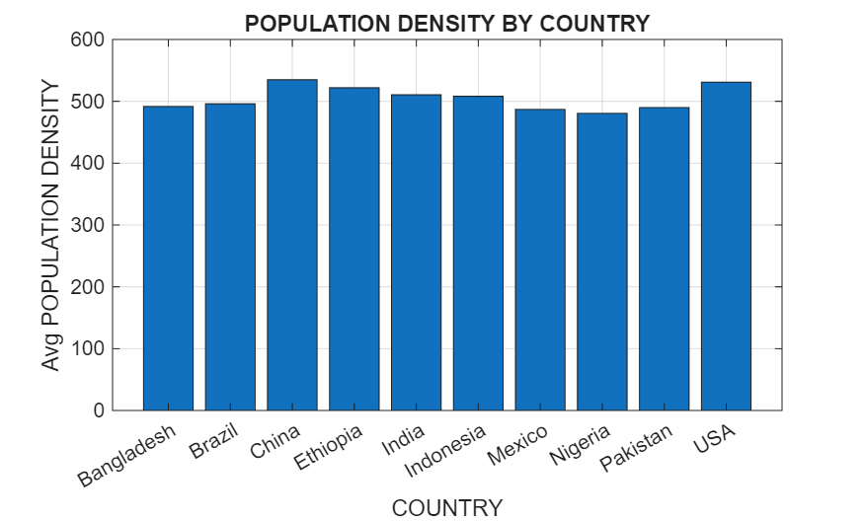
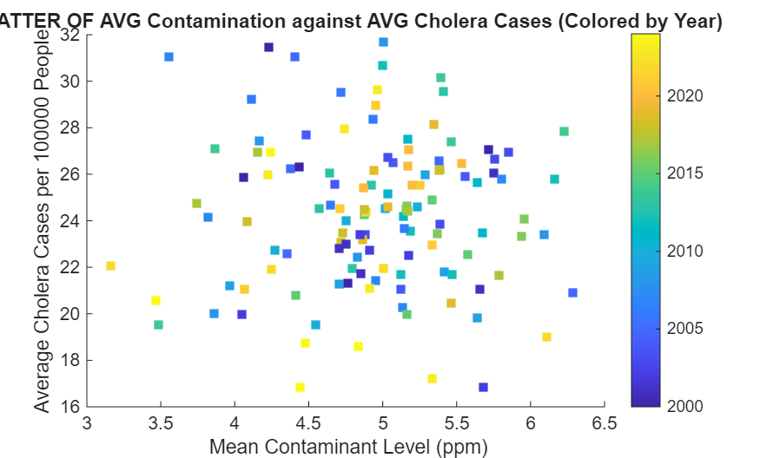
Population Density & Contaminant Levels
Visualising population density by country and the relationship between contaminant levels and cholera cases.
Scatter plot illustrating the relationship between average contaminant levels and average cholera cases, coloured by year.
scatter(CO,CH,40,regionYearSummary.Year,"s","filled")
Bar chart showing average population density by country.
bar(categories(categorical(C_summary.Country)),
C_summary.mean_PopulationDensity_peoplePerKm__)

Slide 9
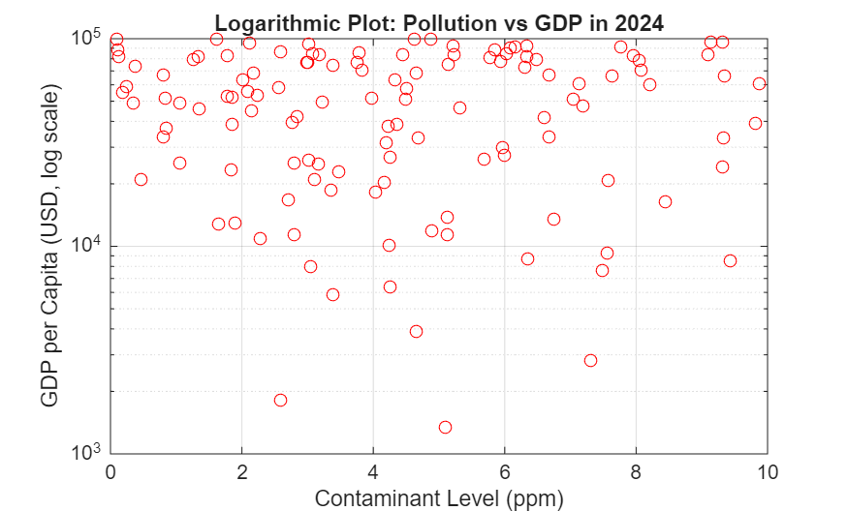
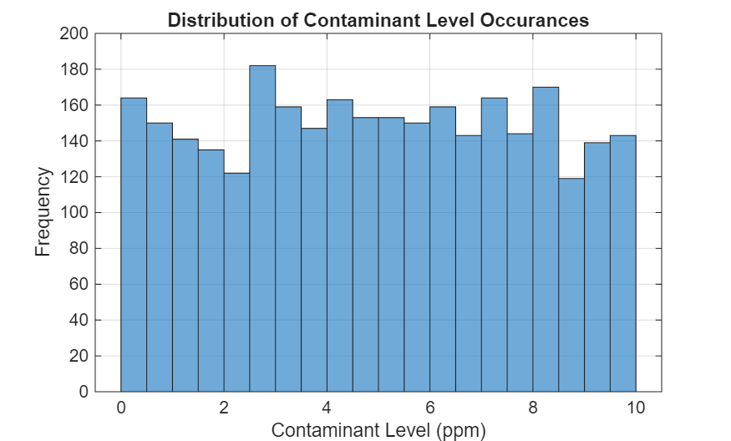
Distribution of Contaminant Levels & GDP
Histograms show the distribution of contaminant levels and GDP per capita, while a logarithmic plot reveals the relationship between pollution and GDP.
GDP per Capita Distribution
Contaminant Level Distribution
Logarithmic plot illustrating the relationship between contaminant levels
and GDP per capita in 2024.
histogram(wpmain.ContaminantLevel_ppm_)
semilogy(wp_2024.ContaminantLevel_ppm_,wp_2024.GDPPerCapita_USD_,'r O')

Slide 10
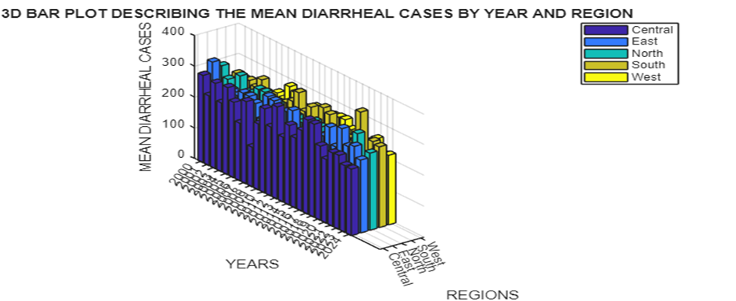

Slide 11
Distribution of Diarrheal Cases by Year & Region (3D PLOTS)
Summarizing data by year and region showing mean diarrheal cases.
regionYearSummary2 = groupsummary(wpmain,["Year","Region"],"mean","DiarrhealCasesPer100_000People");
This line of code was used to delete the groupcount column that automatically appears when using groupsummary.
regionYearSummary2.GroupCount = [];
We used to “unstack”, to convert the region column to a row.
regionYearSummary3 = unstack(regionYearSummary2,('mean_DiarrhealCasesPer100_000People','Region’);
Convert the table into numerical array form
t1 = table2array(regionYearSummary3(:, 2:end));
3D Bar plot
figure(Position=[100,100,1200,650])
bar3(t1)

Slide 12
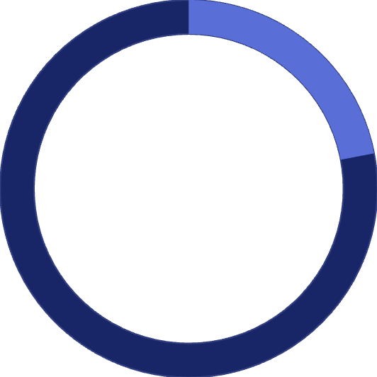
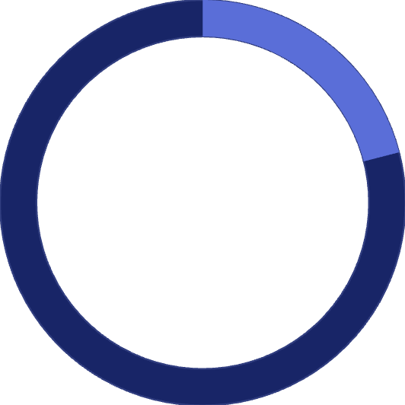
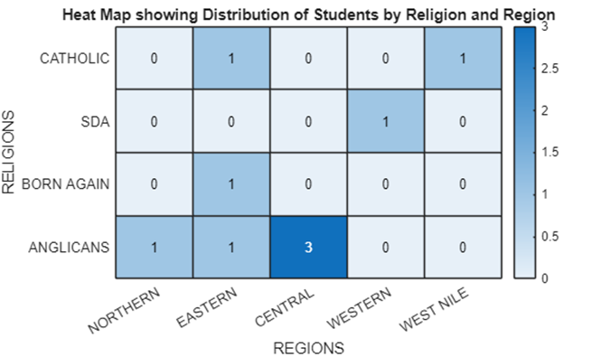
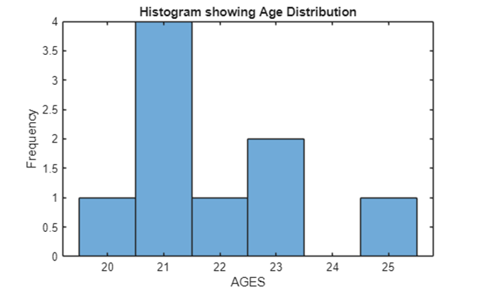
Group 19: Statistical Characteristics
We analysed the statistical characteristics of Group 19 members, including age distribution, religious affiliation, course enrollment, regional distribution, and gender.
22
21
Average Age
Median Age
Mean age of group members.
Median age of group members.
heatmap(REGIONS,RELIGION,Rdata)
histogram(Student_Table.Age)

Slide 13
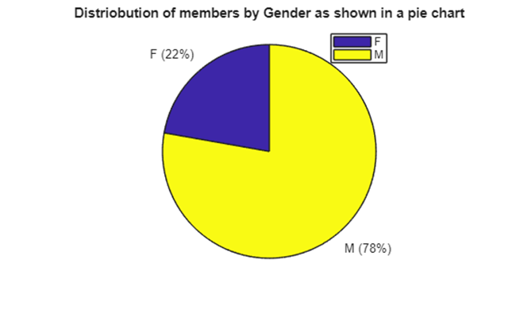

Conclusion & Future Outlook
This project successfully demonstrated MATLAB's capabilities in statistical analysis and data visualisation, transforming raw data into actionable insights.
"The project showed us how unprocessed data, whether from datasets externally obtained or from an individual’s records, can be converted to figures in an ordered and readable format."
We overcame the challenge of summarising a large dataset (3000 rows) by effectively utilising MATLAB's groupsummary function.

